Slide 1
Life Settlement Policies
A Truly Alternative Asset Class
September 2005

Slide 2
Life Settlements Policies
Introduction to Life Settlements
What is a Life Settlement ?
Features of a Life Insurance Policy
Drivers behind Life Insurance Purchase
Policyholder Rationales for Selling Life Policies
Traditional methods of disposal
Foundations for a Secondary Market
The Life Settlement Process
Benefits of Trading a Policy in the Secondary Market
Many Reasons…
Geographic Comparison of Life Settlements Markets
Geographic Comparison of Secondary Markets
US Life Settlements offer the most opportunities
The US Life Settlement Markets
Life Expectancy of US Individuals at age 65
US Life Settlement Market – Current
Growth Drivers of the US Life Settlement Market
US Life Settlement Market – Potential
Portfolio Construction
Constructing a portfolio
General Structural Requirements
General Portfolio Parameters
Structures Available from Commerzbank
Life Settlement Certificates
Capital Protected Life Settlement Note

Slide 3

Introduction to Life Settlements

Slide 4
What is a Life Settlement ?
A Life Settlement is a transaction in which policyholders sell an existing life insurance policy for more than its cash surrender value to a third party. The third party will continue to make premium payments on the policy to the life insurer, until the death of the insured. The death benefit, or Face Value, will then be collected by the third party.

Slide 5
Life Settlement vs Viatical Settlement
The term ‘Viatical Settlements’ is typically used to refer to transactions where the insured can be any age, but is terminally or chronically ill and has a life expectancy of less than 24 months. Doctors will base this assessment on the nature of the illness or condition, and a review of the persons medical records. Viatical Settlements on relatively young insureds have very high exposure to advances in medical science and this caused some issues for investors in the early 1990’s.
The term ‘Life Settlements’ is used to refer to transactions where the insured is over the age of 65. A Life Settlement may of course become considered as Viatical if the insureds health deteriorates markedly.
This presentation is primarily concerned with Life Settlements.

Slide 6
Features of a US Life Insurance Policy
  Face Value or Death Benefit
  A premium stream which needs to be paid to the Insurance company
  Can be ‘Whole’, ‘Universal’ or ‘Term’ type Life Insurance Policies
    ‘Whole Life Insurance’ has constant premiums over its life. These policies usually have an automatic maturity at the age of 100. The automatic maturity could result in a wide range of outcomes depending on the exact wording of the policy.
    ‘Universal Life Insurance’ allows the holder flexibility to adjust the levels of premiums, take premium holidays or extend the term of the policy.
    ‘Term Life Insurance’ provides protection for a pre-defined period only. Often, such policies allow switching to a Universal type close to maturity.

Slide 7
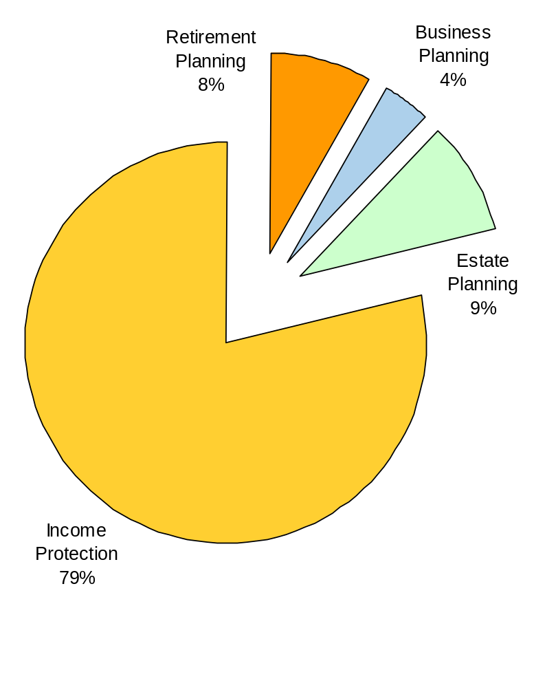
Drivers behind Life Insurance Purchases
  Coverage of Partners and children
  Funding of Inheritance Tax
  Insurance of Key persons within company management
  Coverage of real-estate or company funding
Source: Bernstein Research Call, 2005

Slide 8
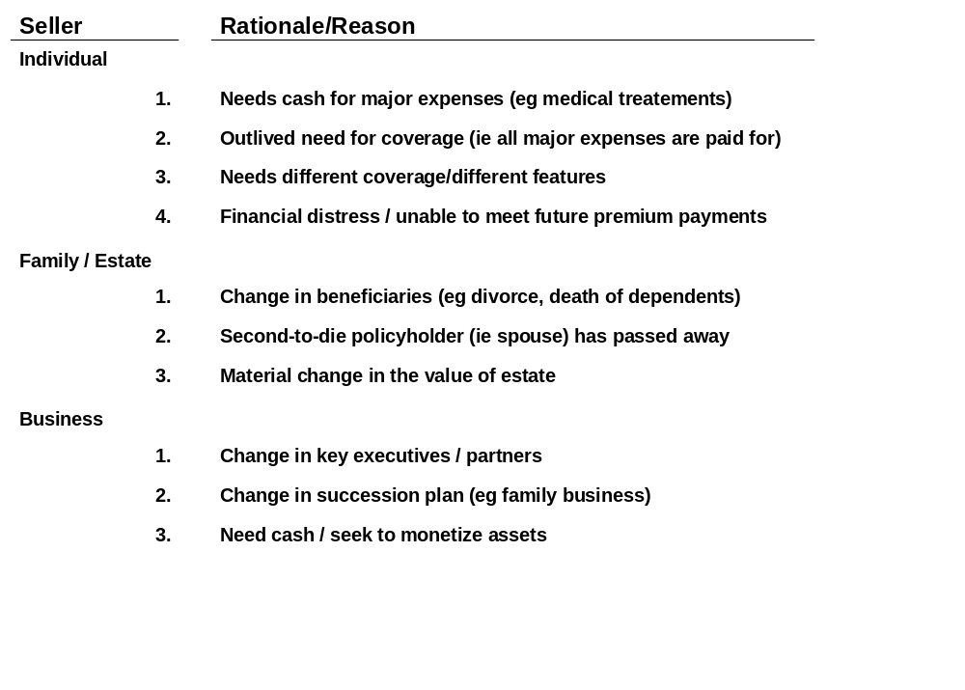
Policyholder Rationales for Selling Life Policies

Slide 9
Traditional methods of disposal
Traditionally only two methods to dispose of ones Life Insurance Policy:
  Lapse Forfeit all premiums paid and forego any potential Death Benefit
  Surrender The sale of the Policy back to the Insurance company at a price suggested by them.
88%
of Universal Life Policies never result in a death claim. They are either surrendered, or worse, allowed to lapse...
Source: CoventryFirst

Slide 10
Foundations for a Secondary Market
  Change in financial priorities or personal circumstances of the insured
  Lapsing the Policy is not attractive
  ‘Surrender Value’ offered by Insurance Company is low - as based on old medical data and in some cases is simply based on surplus cash availability to the insurer..
  ‘Market Value’ offered by 3rd parties could be higher - based on mortality tables and up-to-date medical examinations
  Fiduciary responsibility of IFAs has heightened the awareness of the potential Market Value of Policies

Slide 11
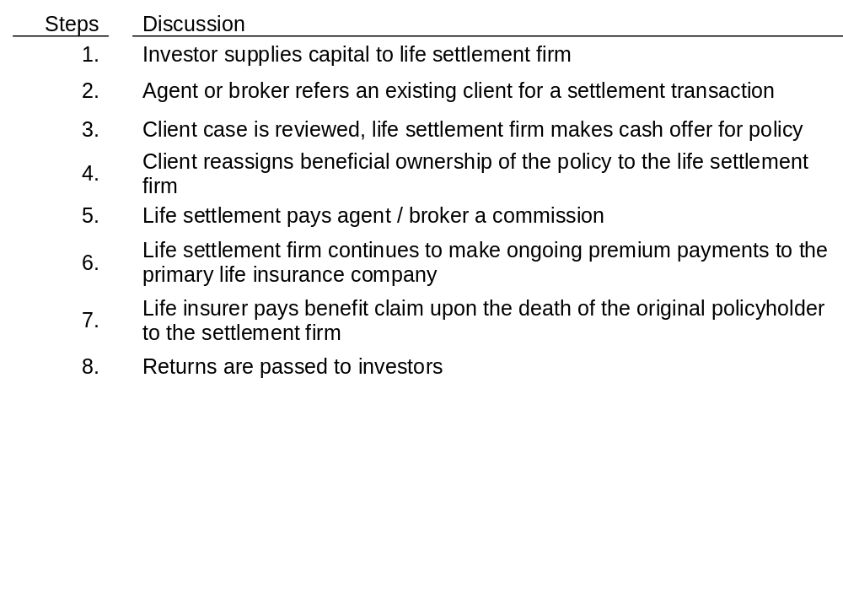
The Life Settlement Process
Insurance
Companies
7
6
Policyholders
Agents/Brokers
3
5
2
4
Life Settlement
Companies
1
Investors
8

Slide 12
Example Case
  Initial Position
    The insured: John Doe (JD), born in 1918, takes out a Whole Life policy in 1990 with Met Life (A+) following the advice of his agent. The Face Value of the policy is $3,000,000 and the annual premiums amount to $90,000 pa.
    2003: JD has suffered wealth losses in the equity markets and his tax situation has now changed - and furthermore the annual premiums are becoming burdensome. The agent suggests that JD sells his policy in the secondary market.
  Selling the Policy
    The broker representing JD owes him the fiduciary duty to act according to his instructions and the obtain the best possible result by securing 2 bids from different providers. The providers represent the investors.
    After a maximum of 2 weeks, JD is informed that the highest bid is $810,000. This compares favourably with a surrender value of $450,000 provided by Met Life.
    After settlement of the transaction, which usually takes 3-6 weeks, JD becomes simply the insured person (as opposed to the insured and the policyholder) and the buyer becomes the new beneficiary of the policy.

Slide 13
Example Case cont..
  Consequences for the buyer
    Has to pay $810,000 to become the policy beneficiary
    Is now responsible of paying all future premium payments of $90,000 pa, until the policy matures. The estimated remaining Life Expectancy of a male aged 87 is 6 years, so the buyer could expect to pay away a further $540,000 in premiums.
    Upon maturity, the buyer will receive the full Face Value of $3,000,000.
  Potential returns
    If maturity occurs after 4 years (Age 89) 23.92%
    If maturity occurs after 6 years (Age 91) 14.62%
    If maturity occurs after 10 years (Age 95) 6.86%.

Slide 14
Benefits of Trading a Policy in the Secondary Market..
...for the seller
Activates income from an inactive asset
Realise a surplus compared to the surrender value offered by the insurance company
Boosts future cashflow situation as seller no longer has to maintain the policy premiums
...for the investor
Acquires policy at a discount to the Face Value gives the potential for high returns
Asset has low correlation with traditional financial assets

Slide 15
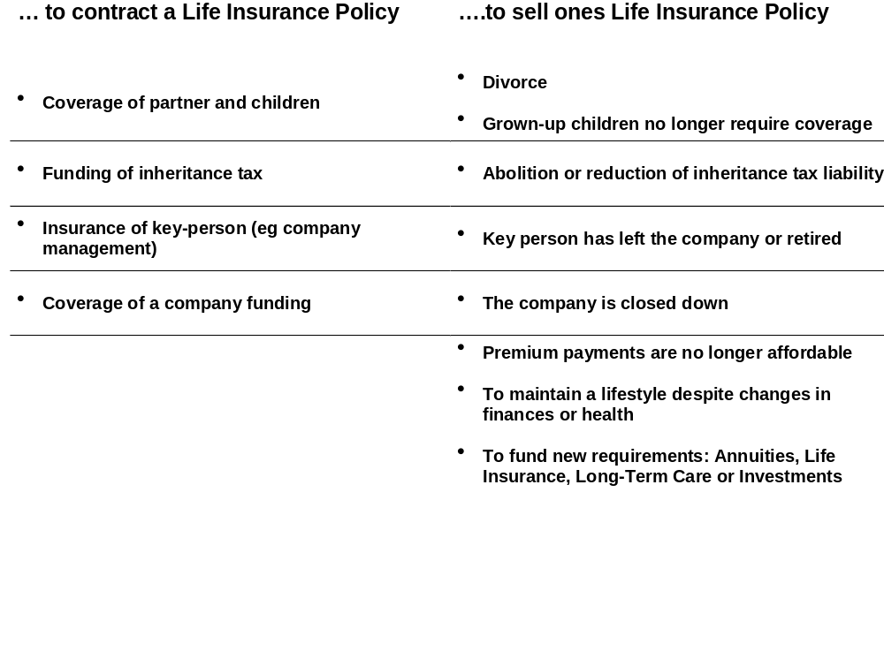
Many Reasons....

Slide 16

Geographic Comparison of Life Settlement Markets

Slide 17
Geographic Comparison of Secondary Markets
US
UK
Germany
Market Lapse Rate
75%
30%
50%
Settled on Secondary Market
3%
60%
5%
Efficient ?
No
Yes
No
Legal Issues
Maturity Date
Open
Fixed
Fixed
Face Value
Fixed
Variable
Variable
Change of ownership
Yes
Yes
Yes
Switching on insured person
No
No
No
Change of beneficiary
Yes
Yes
Yes
Face Value dependent is on:
Profitability of Insurance Company
No
Yes
Yes
Return from Capital Markets
No
Yes
Yes
Death of Insured Person
Yes
Yes
Yes

Slide 18
US Life Settlements market is the most attractive
  Face Value is known
  The Face Value is fixed in US Life Policies, whereas in the UK and Germany, the final Face Value depends on investment returns experienced in the Capital Markets.
  Market is currently relatively inefficient
    Allows for greater potential returns
  Law allows for easy change of ownership
  Allows investor to specifically take (non) mortality risk
  As the premiums and Face Value are both known, this allows the investor to specifically take the mortality risk component as compensation for potentially excess returns.

Slide 19

The US Life Settlement Market

Slide 20
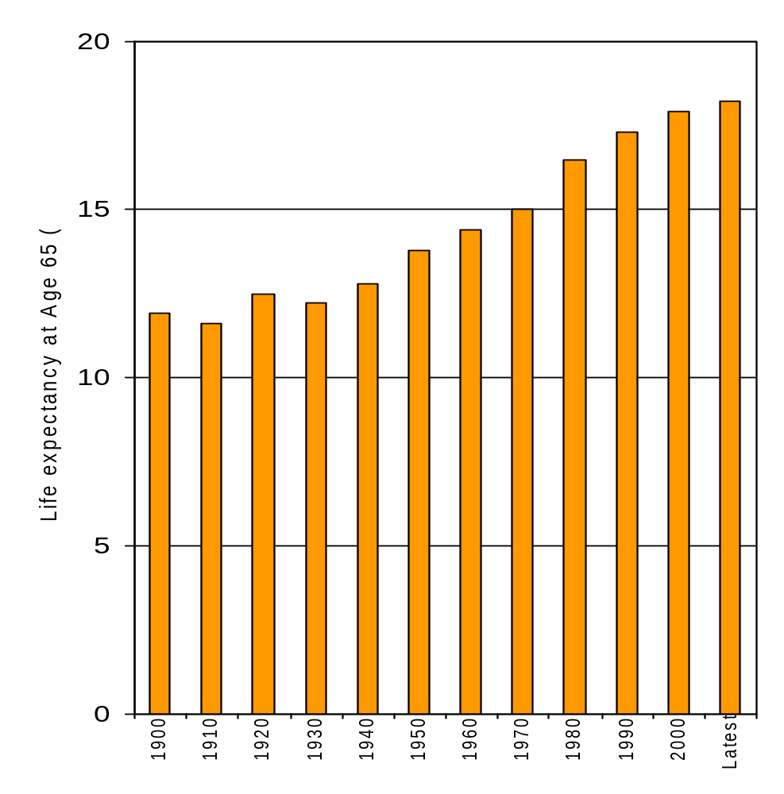
Life Expectancy of US Individuals at the Age of 65
  Life Expectancy has been increasing
  Rate of increase is slowing
  Effect of obesity is starting to show up in the statistics
  Source: CDC and National Vital Statistics System

Slide 21
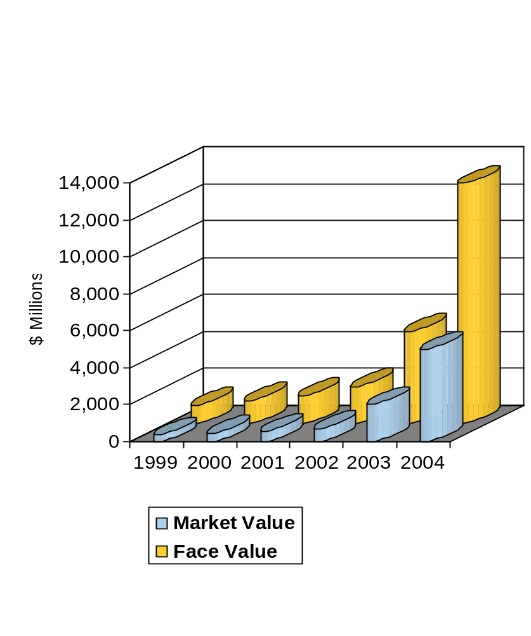
US Life Settlement Market - Current
  $1.5 Trillion
in Life Insurance either lapses or is surrendered annually
  $490 Billion
is the total volume of current Life Insurance Policies eligible for the secondary market -ie where the insured are over the age of 65.
  $100 Billion
is the total current volume of outstanding Life Insurance Policies where the market value exceeds the surrender value (estimate by CoventryFirst)
  3%
is the current market penetration rate. Traded Face value expressed as a percentage of total volume eligible.

Slide 22
Growth Drivers of the US Life Settlements Market
  Individuals in the US are living longer
  Historically, the life expectancy at age 65 has increased by 0.6 years every decade. These individuals may live beyond the age at which they need to provide financial support for their dependents - and therefore may not have the same need for life insurance as when the policy was first purchased.
  Proportion of elderly within the general population set to rise:
  The target market for life settlements, ie those above 65 years of age, is set to grow 3x faster than the total population over the next 25 years. (US Census Bureau)
  Current low interest rates
  Surrender values may be lower than prior expectations due to low re-investment returns, this may make the sale to a life settlement company relatively more attractive to policyholders.
  Potential elimination of the estate tax.
  “The permanent repeal of the death tax would mean that many more family businesses would be preserved and could thrive as a source of continuing job creation and economic growth” (Executive Office of the President, June 2003).
  Fiduciary duty on the part of financial planners
  Financial planners, agents and brokers will feel an increasing responsibility to present life settlements as an option to policyholders, as opposed to simply accepting a surrender value.

Slide 23
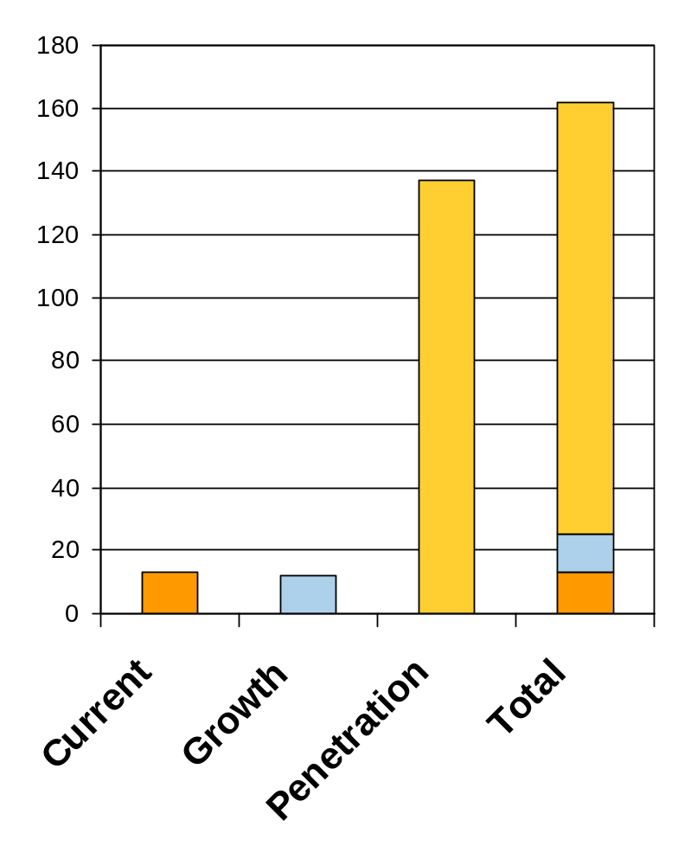
US Life Settlement Market - Potential
  $13Bn
  Using current market of $13Bn in Face Value traded as a basis
  + $12Bn
  Growth in the population over the Age of 65 over next 25 years, based on current demographics, would add a further $12Bn
  + $137Bn
  Current penetration rate is 3%, industry sources expect this to rise to 20%. This reflects expectations in terms of the proportion of policies with low surrender values and the number of people willing to settle.
  = $160Bn
  An estimate for the total market size, in terms of Face Value traded, by 2030.
  Source: Bernstein Research Call, 2005

Slide 24
US Life Settlements - Q&A
  What happens if the Insurance Company goes bankrupt ?
  Even if a Insurance Company fails to maintain its positive solvency margin, and so fails, there could well be enough assets to cover their potential liabilities on the policies they have issued. As a further source of comfort, all US Life Settlement are potentially covered by the State Guarantee Fund. Such funds have limited resources and will pay out up to a maximum amount per insured. This cap is between $200-$300,000 for each life insured.
  How does one know when a policy matures ?
  Most market participants employ 3rd party tracking companies to stay up-to-date on the condition of each life insured. Usually they do this through the simple use of reply-paid postcards and, on a less frequent basis, they will contact the doctor of the insured. Upon maturity, the tracking company will obtain copies of the necessary documentation and forward this to the policy custodian.
  What if the life insured disappears ?
  The mobility of the insured is usually severely restricted, as they often require regular medical attention or even reside in assisted living centers. Still, if an insured was to vanish, the tracking company would employ private investigators to locate the individual. In any case, US Law provides that all missing persons can be presumed deceased after an absence of 7 years and perhaps sooner. This law was specifically crafted to enable Life Insurance claims.

Slide 25
US Life Settlements - Q&A cont..
  What if the Insurance Company refuses to pay the policy benefits ?
  During the first 2 years after the commencement of a policy, that policy is contestable by the insurance company. If , during this period, the policy is sold or death occurs, the Insurance Company could re-examine the policy and even sue to rescind claiming material misrepresentation. After the conestability period, Insurance Companies aroe bound by contract and state law to pay the entire net death benefit to the holder upon maturity, regardless of any material misrepresentations.
  What if the policy expires ?
  The only policies which expire after a certain date with no cash value are ‘Term Policies’. By avoiding these, and sticking to Whole-Life or Universal Life type policies the expiry risk is eliminated.
  What happens if the insured person lives longer than expected ?
  This should always be expected within any portfolio, likewise there will be some policies which mature earlier than expected. By concentrating on Life Settlements rather than Viatical Settlements, the risks of large changes in life expectancies is minimized. Furthermore, when considering a portfolio of Life Settlements such risk is further reduced.
  How does this relate to the Viaticals debacle of the early 1990’s ?
  In the early 1990’s Viatical Settlements provided very disappointing investment returns as the lives which were considered impaired due to AIDS suddenly had their life expectancies extended due to medical advances. Life Settlement returns do not rely on impaired lives, but rather on the natural ageing and attrition of the population.
  .

Slide 26
US Life Settlement Policies - Risks vs Rewards
Potential Risks
Bankruptcy of the Insurance Companies
Longevity of the Insured
Premium stream management/cash management
Potential Rewards
Market currently represents a true arbitrage, as the surrender value offered by the Insurance Company is artificially low.
Asset has low correlation with traditional financial assets.
Potentially high returns
The risks can be greatly diminished by investing in a well managed portfolio of Life Settlements with strict policy selection criteria

Slide 27

Portfolio Construction

Slide 28
Constructing a Portfolio
  If a sufficiently large and diversified portfolio of Life Settlement Policies is assembled, then the resulting portfolio will behave in a very stable manner while still yielding excess returns.
  Minimum number of policies required in order to achieve this effect is 120.
  Estimated annual net (after fees) returns achievable are 8-12% pa in USD
  Portfolio yield will vary according to the average target LE (Life Expectancy) which has been used to construct the portfolio. The higher the LE, the higher the potential returns.
  A portfolio, managed with an average LE of 12 years will become highly cash generative after 8-9 years
  The underlying asset class is still illiquid, so the portfolio should be assembled and maintained, with as few policy disposals as possible. Cash management becomes important.
  Only allow Universal-Life and Whole-Life policies in the portfolio
  Focus predominantly on Life Settlements as opposed to Viatical Settlements
  The most efficient way to manage such a portfolio is through a fund structure.

Slide 29
General Structural Requirements
  Monthly valuations
  Fund management company must be regulated by the appropriate supervisory authorities
  Investment advisor must demonstrate experienced in this field, be independent and also be fully regulated by the appropriate supervisory authorities.
  All policies must have passed their contestability period
  Policy Valuations to be checked by independent parties every month
  Full actuarial audit to be performed annually by independent, recognized, actuarial auditors
  Full financial audit to be performed annually by independent auditing firm
  Independent fund administrator
  Independent Trustee/Escrow agent
  Fund manager must have satisfied the due diligence process of Commerzbank

Slide 30
General Portfolio Parameters
Minimum Criteria
Target Portfolio
Number of Policies
500
120
Minimum Age of Insured
65
72
Policies by insurance companies rated A or above
Min 80%
Min 80%
Maximum allocation to single insurance company
Max 25%
Max 10%
All policies covered by relevant State Life Insurance Guarantee fund ?
Yes
Yes
All policies passed their Contestability Period ?
Yes
Yes
Max holdings in Viaticals (not intended for purchase)
Max 10%
Max 10%

Slide 31

Structures available from Commerzbank

Slide 32
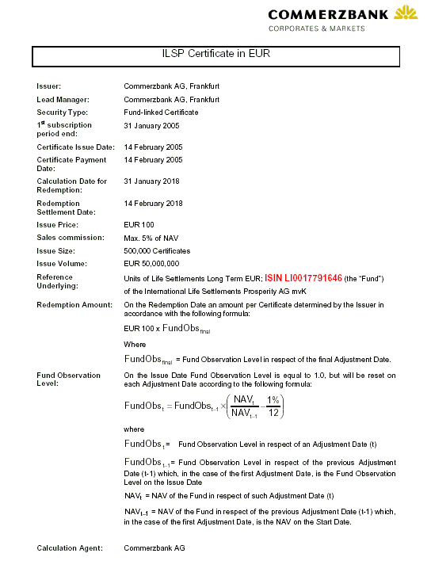
Life Settlement Certificates
Product Highlights
  Provide 100% exposure to portfolio of Life Settlements within a fund
  Annual Fee of just 1%
  No Knock-out Risk
  Small denominations
  EUR and USD Certificates
  Low correlation with existing asset classes
  ISIN: XS0212336415 / XS0212335870

Slide 33
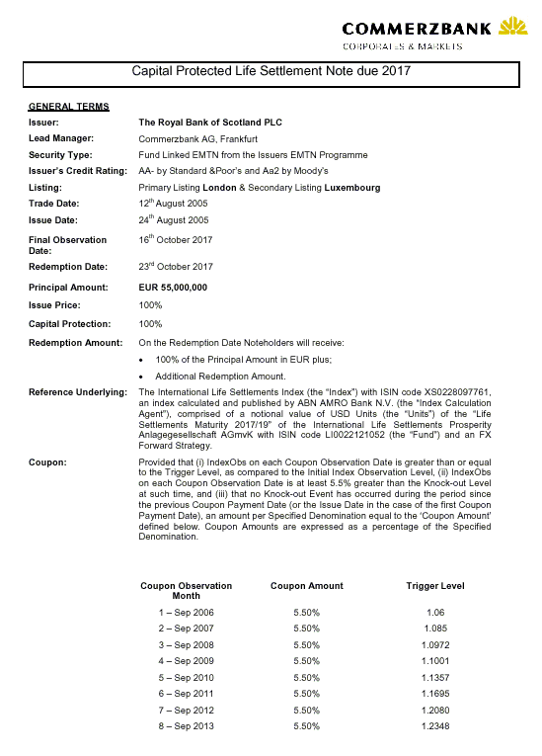
Capital Protected Life Settlement Note
Product Highlights
  12-Year Note, in EUR
  Capital Protection provided by RBS
  100% Exposure to ‘Life Settlement Index’, based on fund value
  Potential for annual 5.5% coupon
  Potential for additional redemption amounts at maturity if the index performs
  Listed in London and Luxembourg
  50,000 EUR denominations
  ISIN: XS0227858262

Slide 34
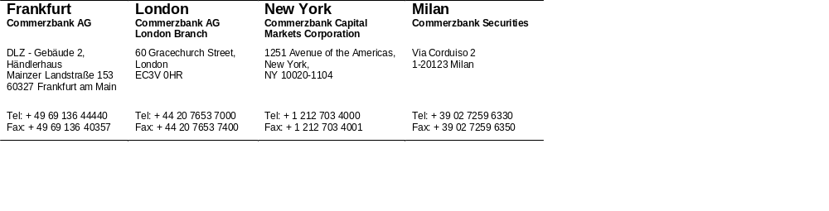

Disclaimer
This document has been prepared and issued by Commerzbank AG which is regulated by the Securities and Futures Commission for the conduct of regulated business in the Hong Kong. Commerzbank AG is a registered institution in Hong Kong licensed to carry on types 1,4, and 6 regulated activities under the Securities and Futures Ordinance. Any reference to “Commerzbank” includes Commerzbank AG and/or subsidiaries and affiliates. This document is only intended to be provided to PERSONS WHO ARE professional investors (as defined in the Securities and Futures Ordinance, Cap.571) of Hong Kong and any rules made thereunder AND to persons whose ordinary business is to buy or sell shares or debentures. This document is not intended to be distributed to private investors or private customers, and in particular Commerzbank does not allow the redistribution of this document to non-professional investors and cannot be held responsible in any way for any third parties who effect such redistribution. The products distributed by Commerzbank should not be offered for re-sale/re-distribution other than in circumstances which do not constitute an offer to the public within the meaning of the Companies Ordinance (Cap.32) of Hong Kong and to persons outside Hong Kong or only to “professional investors” within the meaning of the Securities and Futures Ordinance (Cap. 571) and any rules made thereunder. All recipients of this document should note that it is being furnished to them solely for their information and may not be reproduced or redistributed to any other person. In particular, neither this document nor any copy hereof may be taken into or transmitted into any country where it would be restricted by law and persons into whose possession this document comes should inform themselves about, and observe, any such restrictions. Any failure to comply with these restrictions may constitute a violation of the laws of any such jurisdictions. Any information in this document is based on data obtained from sources considered to be reliable, but no representations or guarantees are made by Commerzbank with regards to the accuracy of the data. Commerzbank accepts no responsibility or liability whatsoever for any expense, loss or damages arising out of or in anyway connected with the use of all or any part of this report. Any terms quoted within this document are indicative and are subject to change at any time without notice. Numerous assumptions have been made in the preparation of this information and no assurance can be given as to the accuracy and/or completeness. Commerzbank group has no direct control over the factors that may affect the price of the instrument. However it may have positions and effect transactions in markets or instruments identical or economically related to the underlying asset of any investment and these actions may have an effect on the price. Commerzbank group may act as an issuer and/or sole manager in the issue of some of the investments mentioned. Commerzbank does not accept any duty to advise you as to advise you as to the suitability or otherwise of the transaction and is dealing with you exclusively on the basis that you have sufficient knowledge, experience and/or professional financial, legal, tax and other advice to make your own assessment thereof. Nothing contained herein should be considered investment, legal, regulatory or tax advice. Commerzbank AG and/or its subsidiaries and/or affiliates and their respective directors, officers or employees act solely in the capacity of an arm’s length counterparty and not as an advisor or fiduciary. Recipients should carry out appropriate reviews and obtain independent professional advice to satisfy themselves of the accuracy of any statements herein made. The value of products mentioned herein may go down as well as up and investors may not get back the amount originally invested. This document has been prepared for information purposes. It is not intended to be and should not be construed as an offer or solicitation to acquire, or dispose of, any of the securities mentioned. Any decision to subscribe for, or otherwise purchase any product mentioned must only be made on the information contained in official documentation for the products. Commerzbank may use own or build positions or trade in any such securities and derivatives mentioned in this document and may also sell them whenever considered appropriate.
© 2004 This document may not be reproduced or distributed in any manner without permission of Commerzbank.
This document is not for distribution in Korea.
Singapore: This document is distributed in Singapore by the Singapore branch of Commerzbank AG. You should contact the Singapore branch of Commerzbank AG if you wish to use our services to effect a transaction in any of the products mentioned in this publication.
People’s Republic of China (“PRC”): This document is distributed by Commerzbank AG, Hong Kong Branch and is only intended for financial institutions (as defined under the Interim Rules on the Administration of Derivative Trading Business by Financial Institutions promulgated by the China Banking Regulatory Commission) and no-one else may rely on any information contained within this document. Any derivative transactions by PRC persons may only be entered into by PRC financial institutions which are permitted to conduct derivatives business in the PRC and have obtained all necessary regulatory approvals in the PRC

